Slide 1

COM3123 - Lecture 8
Angular Fundamentals

Slide 2
Topics
Angular File Structure
Angular Architecture Overview
Modules & Components
Angular CLI

Slide 3
Angular CLI

Slide 4



Angular CLI Overview
The Angular CLI is a command-line interface tool that you use to initialize, develop, scaffold, and maintain Angular applications.
Install the CLI using the npm package manager:
To create, build, and serve a new, basic Angular project use the following commands:

Slide 5


Ng Generate: Generate components with Angular CLI
You might need a new component, module, service or any other angular construct.
Instead of creating three (or four with tests) new files manually,
the angular-cli can create these files for you.
https://angular.io/cli/generate

Slide 6


Ng Generate: Useful optional flags
--dry-run : Try things out
--no-spec : No test file
--inline-style : No external style file
combine flags and use short form commands

Slide 7
Angular File Structure

Slide 8
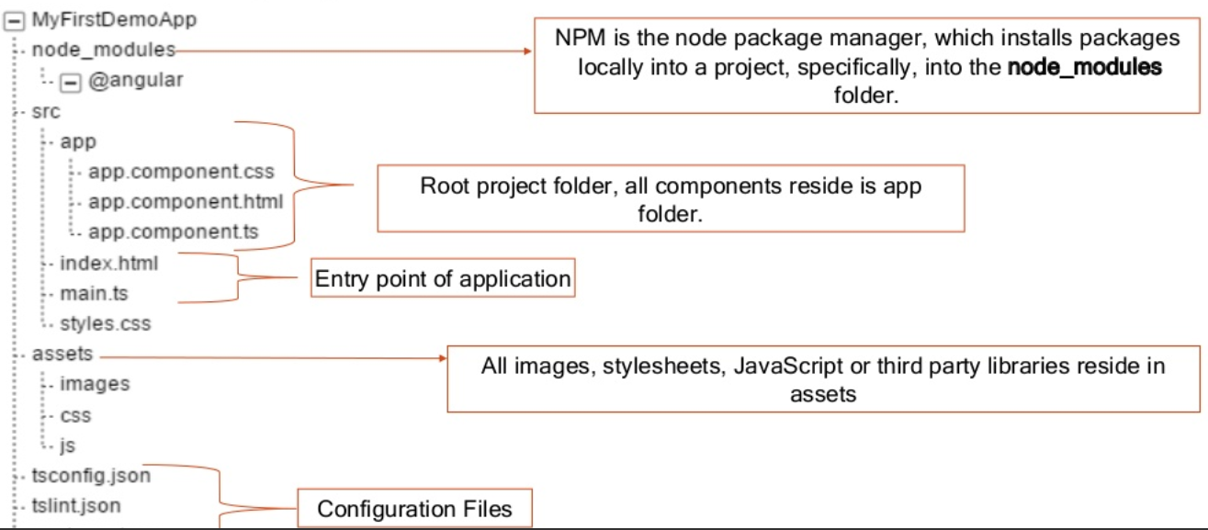
Structure of Angular Application

Slide 9
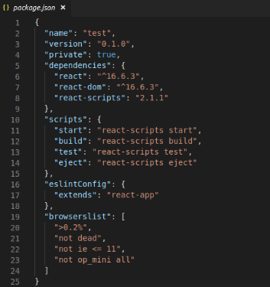
Package.json
Tells us about the project name, project version, typescript version used by the application.
There is some script defined which execute when we run from the terminal like ng serve, ng build, etc.
Configures npm package dependencies that are required for this library.

Slide 10
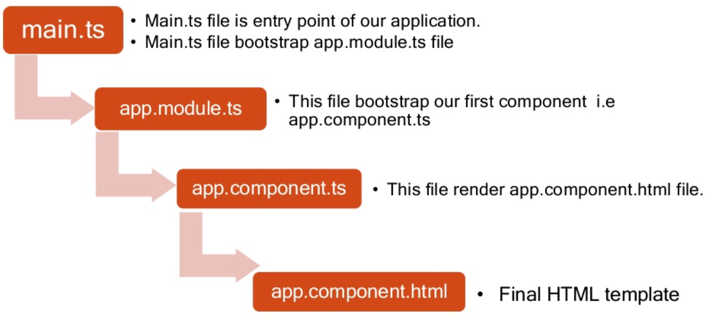
Angular Application Startup

Slide 11
Angular Architecture Overview

Slide 12
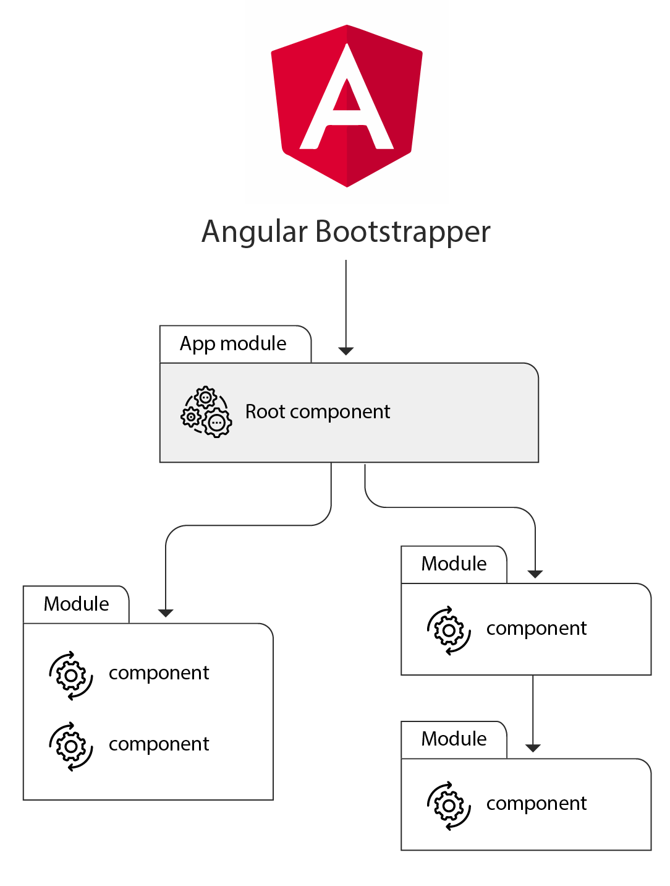
Angular High Level Architecture
An Angular application can be viewed as a tree of components.
The application bootstraps using a component and rest of the application is then rendered with help of a number of sub-components.

Slide 13
Main Building Blocks of Angular
Module
Component
Metadata
Template
Data Binding
Service
Directive
Dependency Injection

Slide 14
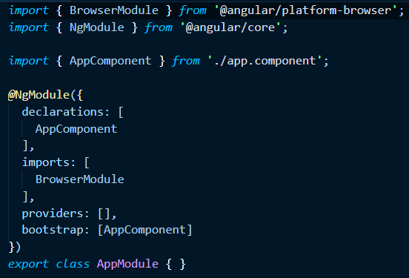
Module
Module is the block of code which is designed to perform a single task.
We can export the module in form of class.
Angular applications have one or more modules.
Every Angular application must have at least one module.
If Angular application contains only one module, it is referring as root module.

Slide 15
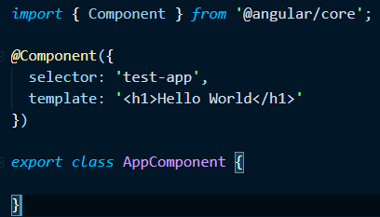
Component
The component is class with the template that deals with the View of application and it’s containing the core logic for the page.
We can compare it with the Controller in Angular 1.x.
We need to write the application logic inside the class which is used by the View.
The component class interacts with the View through Methods and Properties of API.

Slide 16
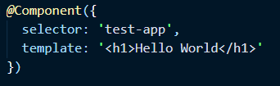
Metadata
Metadata is the way of defining the processing of a class.
In TypeScript, we can define metadata by using decorator.
To define any component in Angular application, we need to tell Angular that this is the component, by using metadata of the class (using @Component decorator).

Slide 17
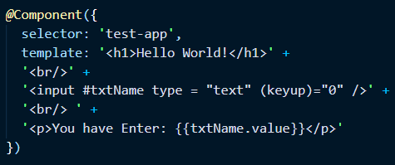
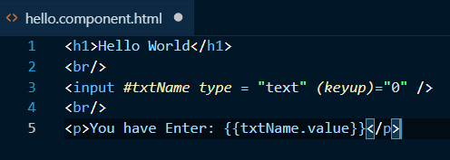
Template
The template is the component View that tells Angular how to display the component. It looks like normal HTML.
The template can be inline to the Component or a seperate HTML view.

Slide 18
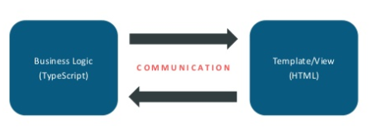
Data Binding
Data Binding is a powerful feature of software development technologies.
Data Binding is the connection bridge between View and the business logic (View Model) of the application.
Data Binding in Angular is the automatic synchronization between the Model and View.

Slide 19
Service
A Service is typically a class with a narrow, well-defined purpose. It should do something specific and do it well.
Services can be used to share the data and the behavior across the application.
Typical examples of services are logging, data and messaging services. There is no base class for a service.

Slide 20
Directives
Directives are one of the most important component of Angular Application
The are extend HTML attributes.
These are the markers on the DOM element which provide some special behavior to DOM elements and tell Angular's HTML compiler to attach.
It is a class with directive metadata.

Slide 21
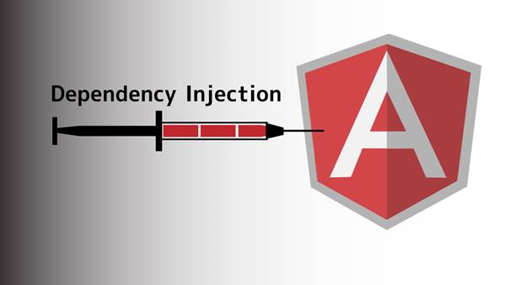
Dependency Injection
Dependency Injection is a software design pattern in which objects are passed as dependencies.
It helps us remove the hard coded dependencies, and makes dependencies configurable.
Using Dependency Injection, we can make components maintainable, reusable, and testable.

Slide 22
Modules

Slide 23
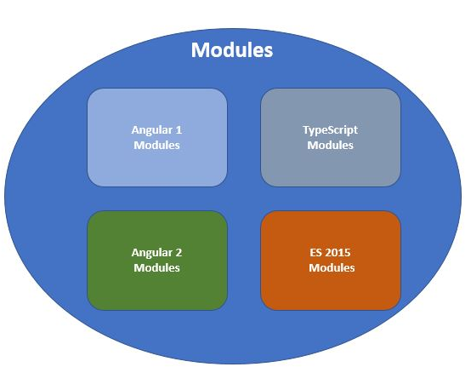
Modules in Angular
In JavaScript we have a problem with namespaces and also with code organization.
Modules provide a solution for this problem. They enable use to decouple our code easier.
Types of Modules
Angular 1 modules
Typescript modules
Angular 2 modules
ES 2015 modules

Slide 24
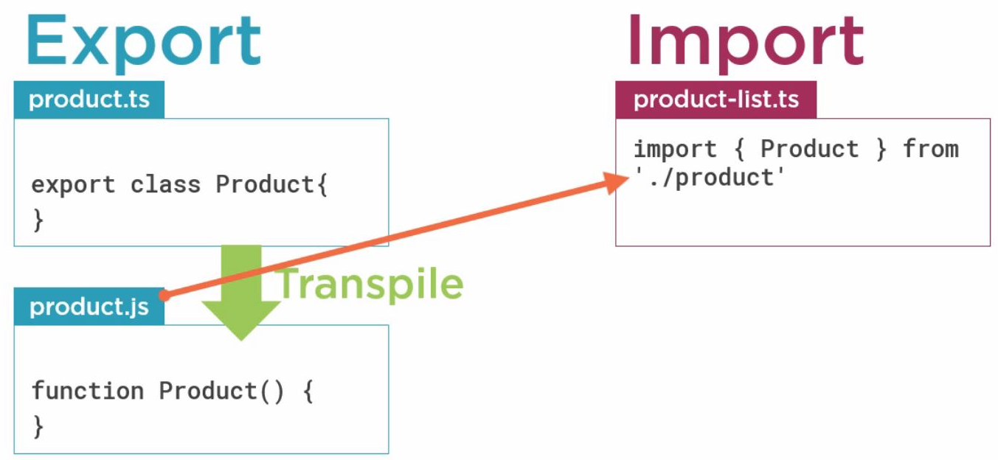
ES 2015 Modules
ES6 modules are stored in files. There is exactly one module per file and one file per module
Before a module can be imported, it first needs to be exported as a module
Once a module has been exported it can easily be imported from another file.

Slide 25
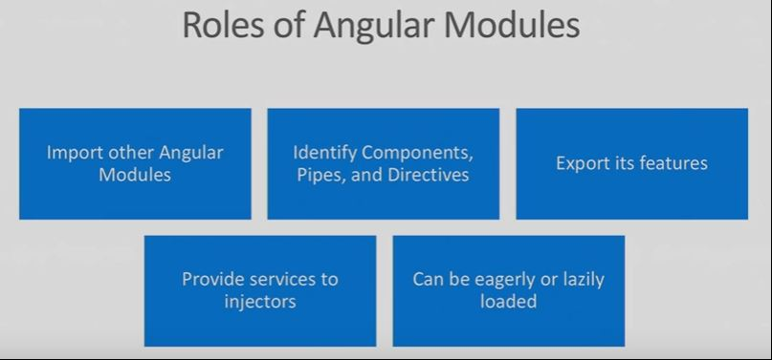
Angular Modules

Slide 26
Angular Modules
Help us organize our application into cohesive blocks of functionality
Every application has at least one module called the root module
An application can have any number of additional feature modules
We can load all modules at the start or lazy load it later

Slide 27
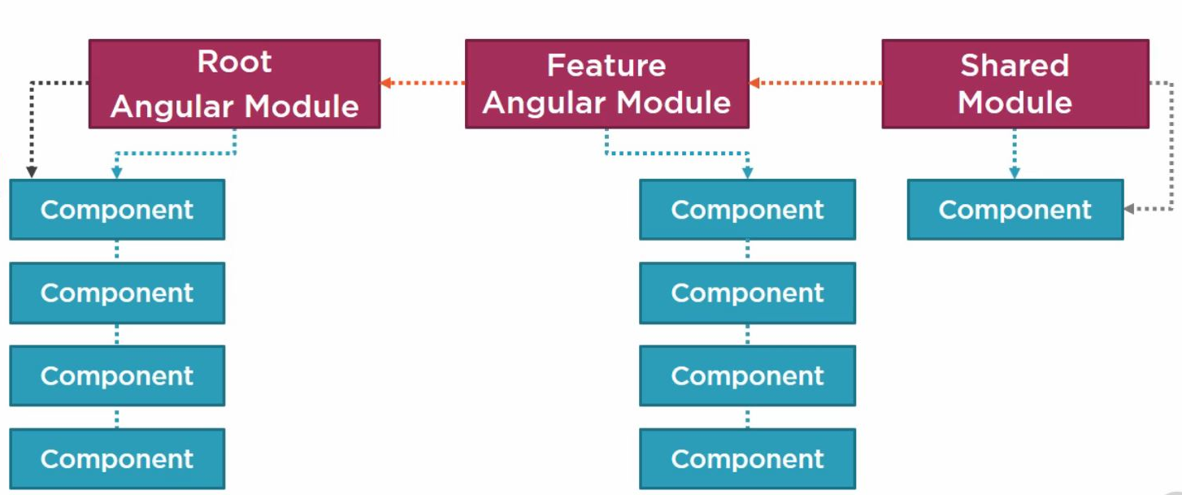
Angular Modules

Slide 28
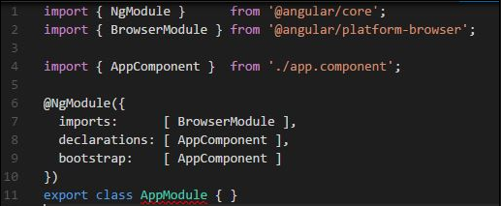
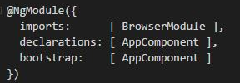
Angular Module cont..
We define an angular module with a class
We identify the angular module by attaching @NgModule decorator and passing the metadata in finding the detail of this angular module.

Slide 29
Difference between ES modules and Angular modules
The main difference is ES files are about code files and angular modules are about our application.
ES Modules
Code files that import or export something
Organize our code files
Modularize our code
Promote code reuse
Angular Modules
Code files that organize the application into cohesive blocks of functionality
Organize our application
Modularize our application
Promote application boundaries

Slide 30
Components

Slide 31
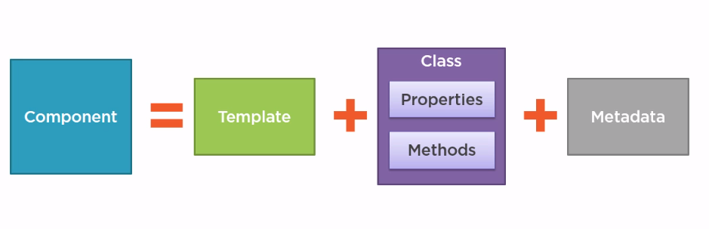
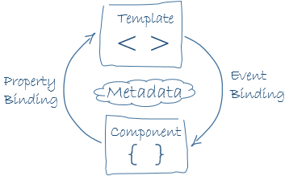
What is an Angular Component?
Components are the most basic building block of a UI in an Angular application
A Component control a part of the screen named the View
The Component’s logic that supports the view is inside a class. The class interacts with View through API.
Each component is comprised of a template, Classes and metadata.

Slide 32
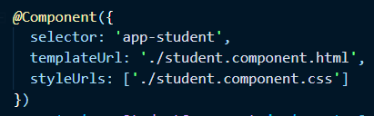
Metadata - @Component Decorator
The @Component decorator decorates a TypeScript class as a component.
It is a function which takes an object as a parameter.
In the @Component decorator, we can set the values of different properties to set the behavior of the component.

Slide 33
Components consists of the following parts:
Selector
Selector defines the name of the HTML tag where this component will render.
Template or TemplateUrl
Template can consists of HTML TAGs and other component as well. It allows us to tie logic from our component directly to a view.
Templates can be external html files or inline html
Styles or StyleUrl
The styles option is used to apply CSS on this component.
Styles can be external or internal
A way of encapsulating styles from the global application

Slide 34
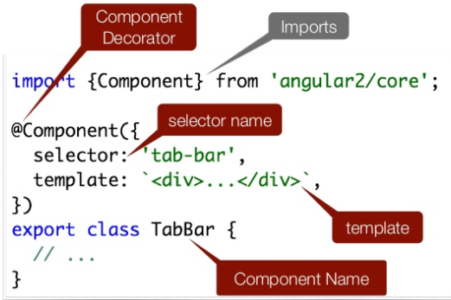
Component TypeScript API

Slide 35
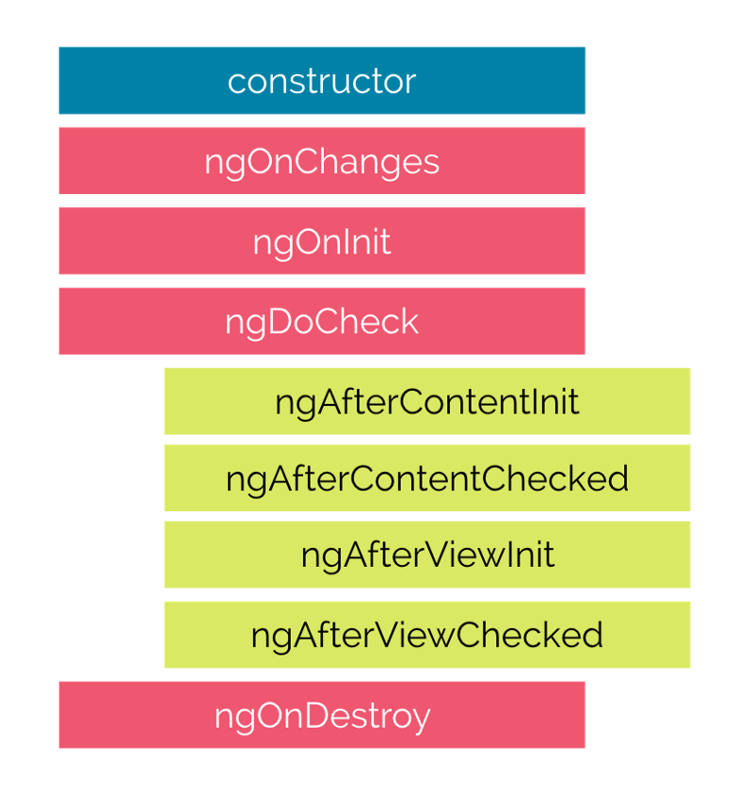
Component Life Cycle Hooks
Components can control their runtime behaviour by implementing various Life-Cycle hooks.
Component instances have a lifecycle as Angular creates, updates, and destroys them.
We can tap into key moments in that lifecycle by implementing one or more of the lifecycle hook interfaces

